Slide 1
MILITARY JUSTICE ACT OF 2016
Panel Selection, Impanelment, and Jeopardy
Military Justice Legislation Training Team

Slide 2
AGENDA
Panel Selection
Alternate Member v. New Member
Process of Impanelment
Alternate Member Replacement
New Member after Impanelment
Jeopardy
Questions

Slide 3
SELECTION CRITERIA (NEW R.C.M. 502(A)(1))
The members detailed to a court-martial shall be those persons who in the opinion of the convening authority are best qualified for the duty by reason of their age, education, training, experience, length of service, and judicial temperament.
Each member shall be on active duty with the armed forces and shall be:
A commissioned officer;
A warrant officer, except when the accused is a commissioned officer; or
An enlisted person, except when the accused is either a commissioned or warrant officer.
Notes:
No substantial change from previous rule

Slide 4
ENLISTED MEMBER (ARTICLE 25 (C)(1))
Article 25(c)(1) previously prohibited enlisted members from the same “unit” from serving on a general or special court-martial
Article 25(c)(1) now reads:
Any enlisted member on active duty is eligible to serve on a general or special court-martial for the trial of any other enlisted member
Notes:
The MJRG recommend the prohibition on enlisted members serving in the same unit be removed. This was to increase the size of the pool in which the convening authority could select members from.
This was also done to shift the focus to the procedures and practice of voir dire.

Slide 5
PANEL SELECTION (R.C.M 503(A)(1))
The convening authority shall
detail qualified persons as members for courts-martial;
detail not fewer than the number of members required under R.C.M. 501(a), as applicable; and
state whether the military judge is authorized to:
impanel a specified number of alternate members; or
impanel alternate members only if, after the exercise of all challenges, excess members remain.
Notes:
Sub bullet two and three are the changes to R.C.M 503. Previous rule read “The convening authority shall detail qualified persons as members for courts-martial.”
Definitions to mention:
Assembly: The act of the convening authority sending members to the court-martial for impanelment (Article 25-29). Within Article 29 it states “The military judge shall announce the assembly of a general or special court-martial with members.”
Impanel: Article 29 states “…after challenges, [the military judge] impanel[s] the court-martial.”
Excess member: any member who was assembled but not impaneled. (Article 29)
Note the process of impaneling and excusing excess members to be explained later in slide deck.

Slide 6
ALTERNATE/NEW MEMBER CURRENT V. NEW
Pre-MJA 16
R.C.M. 504(d) detailed members to the court-martial through a court-martial convening order
R.C.M. 505 ensured, prior to assembly, the convening authority changed members to ensure enough members are present to meet quorum
After assembly, should the panel fall below quorum, the convening authority could appoint “new members” to meet quorum
R.C.M. 805(d)(1) states when a “new member” is detailed the entire record up to current time will be read to the “new member.” This was time consuming and elongated trials
There was no true “alternate member” in the old rules
Post-MJA 16
R.C.M. 912A now allows the convening authority to authorize the military judge to impanel a specific number of “alternate members” in the convening order
R.C.M. 502(a)(2)(B) states “alternate members” have the same responsibilities as the primary members, however, they are not allowed to participate in deliberations on finding or sentencing unless they have become a primary member
Since the “alternate members” are present during trial, should a primary member be excused for any reason, there is no need to read the entire record. This allows the court-martial to continue with no interruptions
There are no changes to the procedures for appointing “new members” after impanelment.
Notes:
The number of alternate members will be set by the convening authority in the court-martial convening order. There will be a specific number or if excess members remain, no more than 3.
Rule 912A. Impaneling members and alternate members
(a)(4) Alternate members. A convening authority may authorize the military judge to impanel alternate members. When authorized by the convening authority, the military judge shall designate which of the impaneled members are alternate members in accordance with these rules and consistent with the instructions of the convening authority.
(A) If the convening authority authorizes the military judge to impanel a specific number of alternate members, the number of members impaneled shall be the number of members required under paragraphs (1), (2), or (3) of this subsection, as applicable, plus the number of alternate members specified by the convening authority. The military judge shall not impanel the court-martial until the specified number of alternate members have been identified. New members may be detailed in order to impanel the specified number of alternate members.
(B) If the convening authority does not authorize the military judge to impanel a specific number of alternate members, and instead authorizes the military judge to impanel alternate members only if, after the exercise of all challenges, excess members remain, the number of members impaneled shall be the number of members required under paragraphs (a)(1), (2), or (3) of this rule and no more than three alternate members. New members shall not be detailed in order to impanel alternate members.

Slide 7
IMPANELING MEMBERS

Slide 8
COMPOSITION OF COURTS-MARTIAL (NEW R.C.M. 501)
The composition of a court-martial is fixed
General Courts-Martial
Non-capital cases
Military judge and 8 members (plus alternate members if authorized by convening authority)
May be reduced to 6 or 7 members after impanelment as a result of challenges or excusals
Military judge alone if requested
Capital cases
Military judge and 12 members (plus alternate members if authorized by convening authority)
Special Court-Martial
Military judge and 4 members (plus alternate members if authorized by convening authority)
Military judge alone if requested
Referral to military judge alone with sentence limitations
How do we get to 4 members plus alternates???
Notes:
The following slide will be used to show how the new impanelment process will work.

Slide 9
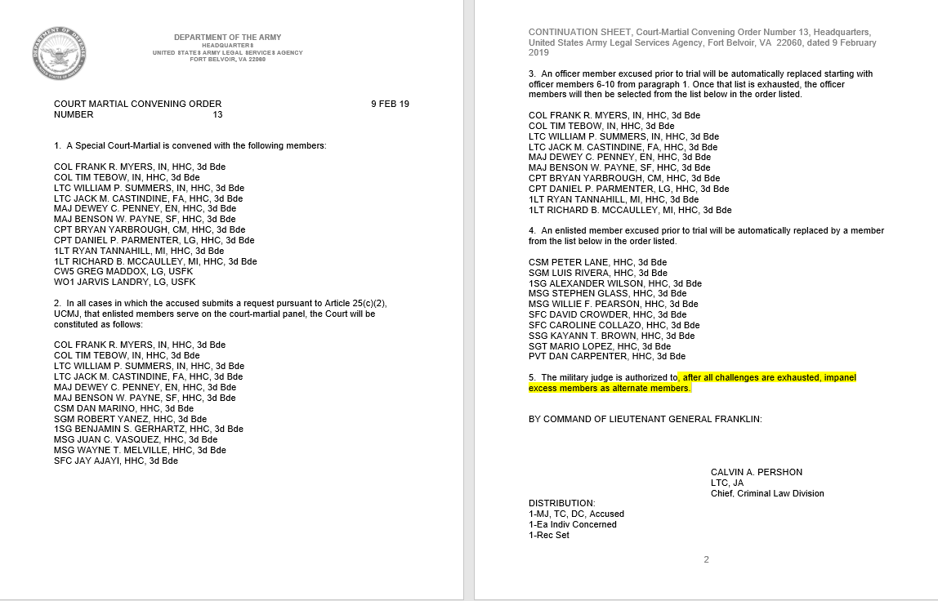
COURT-MARTIAL CONVENING ORDER

Slide 10
SPCM (OFFICER PANEL) PANEL DETAILED BY CONVENING AUTHORITY
Notes:
Although the panels are now fixed, the convening authority is authorized to send more members than required in order to meet the number required to impanel:
Article 25(e)(3): The convening authority shall detail not less than the number of members necessary to impanel the court-martial under section 829 of this title (article 29).
Rule 503(a)(1)(B): detail not fewer than the number of members required under R.C.M. 501(a)…
In this example, the convening authority sent 12 members in order to meet the requirement for 7 members (4 primary members, 3 alternate members). The convening authority authorized alternates if, after the exercise of all challenges, excess members remain.
Recalling a previous slide, R.C.M. 912A now allows the convening authority to authorize the military judge to impanel a specific number of “alternate members” in the convening order.
Steps up to this point:
MJ assembled the court-martial with 12 members present

Slide 11
SPCM (ENLISTED PANEL) PANEL DETAILED BY CONVENING AUTHORITY
* Yellow identifies enlisted panel members
Notes:
The yellow identifies the enlisted panel members. The convening authority detailed 6 enlisted members to the panel to ensure the one-third enlisted member requirement was met.
Rule 503(a)(2): Member election by enlisted accused.
An enlisted accused may, before assembly, request orally on the record or in writing that the membership of the court-martial to which that accused’s case has been referred be comprised entirely of officers or of at least one-third enlisted members. If such a request is made, the court-martial membership must be consistent with the accused’s request unless eligible members cannot be obtained because of physical conditions or military exigencies. If the appropriate number of members cannot be obtained, the court-martial may be assembled and the members impaneled, and the trial may proceed without them, but the convening authority shall make a detailed written explanation why such members could not be obtained which must be appended to the record of trial.

Slide 12
IMPANELING MEMBERS (R.C.M. 912A)
Officer Panel
R.C.M. 912(f)(5) – after the exercise of challenges for cause and before the exercise of peremptory challenges the military judge will issue random numbers
After peremptory challenges the military judge will then impanel the requisite number of members starting with the lowest random number
Enlisted Panel
R.C.M. 912(f)(5) – after the exercise of challenges for cause and before the exercise of peremptory challenges the military judge will issue random numbers
After peremptory challenges the military judge will then impanel the requisite number of members, identifying the 1/3 enlisted population required using lowest random number, then the remaining population required using lowest random number
Notes:
(i) authorized to impanel a specified number of alternate members; or (ii) authorized to impanel alternate members only if, after the exercise of all challenges, excess members remain. [shall not exceed three alternate members]

Slide 13
SPCM (OFFICER PANEL) AFTER CHALLENGES FOR CAUSE AND BEFORE PEREMPTORY CHALLENGES
1
7
4
3
2
9
8
6
5
* Military judge gives each member a random number
Notes:
Steps up to this point:
MJ assembled the court-martial with 12 members present
Voir dire has been completed
The military judge has issued random numbers to the remaining members

Slide 14
SPCM (OFFICER PANEL) PEREMPTORY CHALLENGES
Defense
1
7
4
3
2
9
8
6
5
Notes:
Steps up to this point:
MJ assembled the court-martial with 12 members present
Voir dire has been completed
The military judge has issued random numbers to the remaining members
Peremptory challenges issued
In the old rules, absent the random numbers, the court-martial panel would be sat.

Slide 15
SPCM (OFFICER PANEL) IMPANEL MEMBERS
1
4
3
2
9
8
6
5
* MJ impanels members by lowest random number
Notes:
Steps up to this point:
MJ assembled the court-martial with 12 members present
Voir dire has been completed
The military judge has issued random numbers to the remaining members
Peremptory challenges issued
In the old rules, absent the random numbers, the court-martial panel would be sat.

Slide 16
SPCM (OFFICER PANEL) IMPANEL MEMBERS
Excess Members
9
8
6
1
2
3
4
5
Notes:
Steps up to this point:
MJ assembled the court-martial with 12 members present
Voir dire has been completed
The military judge has issued random numbers to the remaining members
Peremptory challenges issued
The military judge now impanels the members with the lowest random number

Slide 17
SPCM (ENLISTED PANEL) AFTER CHALLENGES FOR CAUSE AND BEFORE PEREMPTORY CHALLENGES
1
7
4
3
2
9
8
6
5
* Military judge gives each member a random number
Notes:
Steps up to this point:
MJ assembled the court-martial with 12 members present
Voir dire has been completed
The military judge has issued random numbers to the remaining members

Slide 18
SPCM (ENLISTED PANEL) PEREMPTORY CHALLENGES
Defense
1
7
4
3
2
9
8
6
5
Notes:
Steps up to this point:
MJ assembled the court-martial with 12 members present
Voir dire has been completed
The military judge has issued random numbers to the remaining members
Peremptory challenges issued
In the old rules, absent the random numbers, the court-martial panel would be sat.

Slide 19
SPCM (ENLISTED PANEL) IMPANEL MEMBERS
1
4
3
2
9
8
6
5
* MJ impanels enlisted members by lowest random number, then remaining members
Notes:
Steps up to this point:
MJ assembled the court-martial with 12 members present
Voir dire has been completed
The military judge has issued random numbers to the remaining members
Peremptory challenges issued
In the old rules, absent the random numbers, the court-martial panel would be sat.

Slide 20
SPCM (ENLISTED PANEL) IMPANEL MEMBERS
Excess Members
9
8
6
1
3
2
4
5
Notes:
Steps up to this point:
MJ assembled the court-martial with 12 members present
Voir dire has been completed
The military judge has issued random numbers to the remaining members
Peremptory challenges issued
The military judge now impanels the members with the lowest random number

Slide 21
IMPANELING ALTERNATE MEMBERS (R.C.M. 912A)
Appointing Alternate Members
After filling panel requirements, identify alternates from remaining members using lowest random numbers
If the CA authorizes the MJ to impanel alternates, the MJ will impanel using the lowest remaining random number
Notes:
See RCM 912(f)(5)

Slide 22
IMPANELING ALTERNATE MEMBERS (R.C.M. 912A)
Examples of language used by the CA:
I do not authorize the use of alternate members.
After identification of primary members, the military judge shall impanel one (1) alternate member.
After identification of primary members, the military judge shall impanel two (2) alternate member.
After identification of primary members, if excess members remain, the military judge shall impanel as alternate members
No more than three members.
I authorize the military judge to impanel alternate members if excess members are available after identification of the primary panel members.
No more than three members.
Notes:
See RCM 912(f)(5)

Slide 23
SPCM (OFFICER PANEL) IMPANEL ALTERNATE MEMBERS
Excess Members
9
8
6
1
2
3
4
5
* After MJ impanels required forum, the MJ will then assign alternates by lowest random number
Notes:
Steps up to this point:
MJ assembled the court-martial with 12 members present
Voir dire has been completed
The military judge has issued random numbers to the remaining members
Peremptory challenges issued
The military judge now impanels the members with the lowest random number
The military judge identifies and impanels 3 “alternate” members with the lowest remaining numbers.
The military judge shall announce that member 5, 6, and 8 are designated as alternate members. (R.C.M. 912A(a)(4))

Slide 24
SPCM (ENLISTED PANEL) IMPANEL ALTERNATE MEMBERS
Excess Members
9
8
6
1
3
2
4
5
* After MJ impanels required forum, the MJ will then assign alternates by lowest random number
Notes:
Steps up to this point:
MJ assembled the court-martial with 12 members present
Voir dire has been completed
The military judge has issued random numbers to the remaining members
Peremptory challenges issued
The military judge now impanels the members with the lowest random number
The military judge identifies and impanels 3 “alternate” members with the lowest remaining numbers.
The military judge shall announce that member 5, 6, and 8 are designated as alternate members. (R.C.M. 912A(a)(4))

Slide 25
EXCESS MEMBERS (R.C.M. 912A)
Removing Excess Members
Any members remaining after impanelment will be dismissed by the military judge
Notes:
See RCM 912(f)(5)

Slide 26
SPCM (OFFICER PANEL) IMPANEL ALTERNATE MEMBERS
Excess Members
Dismissed by military judge
9
5
6
8
1
2
3
4
Notes:
Steps up to this point:
MJ assembled the court-martial with 12 members present
Voir dire has been completed
The military judge has issued random numbers to the remaining members
Peremptory challenges issued
The military judge now impanels the members with the lowest random number
The military judge identifies and impanels 3 members with the lowest remaining numbers.
The military judge excuses the excess member.

Slide 27
SPCM (ENLISTED PANEL) IMPANEL ALTERNATE MEMBERS
Excess Members
Dismissed by military judge
9
5
6
8
1
3
2
4

Slide 28
ALTERNATE MEMBER REPLACEMENT
(R.C.M. 912B)
If alternate members are available, an excused member shall be replaced with an impaneled alternate member
The alternate member with the lowest random number shall replace the excused member, unless in the case of an enlisted accused, the use of such member would be inconsistent with the forum composition
Alternate members excused after impanelment shall not be replaced

Slide 29
SPCM (OFFICER PANEL) ALTERNATE MEMBER REPLACEMENT
5
6
8
1
2
3
4
* Member 1 removed for cause. Alternate member 5 replaces member 1.
Notes:
During the trial member 1 was challenged for cause and removed. Panel member 5 replaces member 1. Trial continues with no interruption.
Rule 912B. Excusal and replacement of members after impanelment
(a) In general. A member who has been excused after impanelment shall be replaced in accordance with this rule. Alternate members excused after impanelment shall not be replaced.
(b) Alternate members available. An excused member shall be replaced with an impaneled alternate member, if an alternate member is available. The alternate member with the lowest random number assigned pursuant to R.C.M. 912(f)(5) shall replace the excused member, unless in the case of an enlisted accused, the use of such member would be inconsistent with the forum composition established under R.C.M. 903.
(c) Alternate members not available.
(1) Detailing of new members not required. In a general court-martial in which a sentence of death may not be adjudged, if, after impanelment, a court-martial member is excused and alternate members are not available, the court-martial may proceed if—
(A) There are at least six members; and
(B) In the case of an enlisted accused, the remaining panel composition is consistent with the forum established under R.C.M. 903.
(2) Detailing of additional members required. In all cases other than those described in paragraph (1), if an impaneled member is excused and no alternate member is available to replace the excused member, the court-martial may not proceed until the convening authority details sufficient additional members.

Slide 30
SPCM (ENLISTED PANEL) ALTERNATE MEMBER REPLACEMENT
5
6
8
1
3
2
4
* Member 1 removed for cause. Alternate member 5 replaces member 1.
Notes:
During the trial member 1 was challenged for cause and removed. Panel member 5 replaces member 1. Trial continues with no interruption.
Rule 912B. Excusal and replacement of members after impanelment
(a) In general. A member who has been excused after impanelment shall be replaced in accordance with this rule. Alternate members excused after impanelment shall not be replaced.
(b) Alternate members available. An excused member shall be replaced with an impaneled alternate member, if an alternate member is available. The alternate member with the lowest random number assigned pursuant to R.C.M. 912(f)(5) shall replace the excused member, unless in the case of an enlisted accused, the use of such member would be inconsistent with the forum composition established under R.C.M. 903.
(c) Alternate members not available.
(1) Detailing of new members not required. In a general court-martial in which a sentence of death may not be adjudged, if, after impanelment, a court-martial member is excused and alternate members are not available, the court-martial may proceed if—
(A) There are at least six members; and
(B) In the case of an enlisted accused, the remaining panel composition is consistent with the forum established under R.C.M. 903.
(2) Detailing of additional members required. In all cases other than those described in paragraph (1), if an impaneled member is excused and no alternate member is available to replace the excused member, the court-martial may not proceed until the convening authority details sufficient additional members.

Slide 31
SPCM (ENLISTED PANEL) ALTERNATE MEMBER REPLACEMENT
EO fix in the works to allow the convening authority to authorize the military judge to “prioritize enlisted members for alternates”
Notes:
During the trial member 1 was challenged for cause and removed. Panel member 5 replaces member 1. Trial continues with no interruption.
Rule 912B. Excusal and replacement of members after impanelment
(a) In general. A member who has been excused after impanelment shall be replaced in accordance with this rule. Alternate members excused after impanelment shall not be replaced.
(b) Alternate members available. An excused member shall be replaced with an impaneled alternate member, if an alternate member is available. The alternate member with the lowest random number assigned pursuant to R.C.M. 912(f)(5) shall replace the excused member, unless in the case of an enlisted accused, the use of such member would be inconsistent with the forum composition established under R.C.M. 903.
(c) Alternate members not available.
(1) Detailing of new members not required. In a general court-martial in which a sentence of death may not be adjudged, if, after impanelment, a court-martial member is excused and alternate members are not available, the court-martial may proceed if—
(A) There are at least six members; and
(B) In the case of an enlisted accused, the remaining panel composition is consistent with the forum established under R.C.M. 903.
(2) Detailing of additional members required. In all cases other than those described in paragraph (1), if an impaneled member is excused and no alternate member is available to replace the excused member, the court-martial may not proceed until the convening authority details sufficient additional members.

Slide 32
NEW MEMBER AFTER IMPANELMENT
(R.C.M. 912B)
If alternate members are not available
Detailing of additional members [new member] is required if an impaneled member is excused and no alternate members are available to replace the excused member
IAW R.C.M. 805(d)(1) trial may not proceed unless the testimony and evidence previously admitted on the merits, if recorded verbatim, is read to or played for the new member in the presence of the military judge, the accused, and counsel for both sides
Detailing of new members is not required in a general court-martial in which a sentence of death may not be adjudged, if:
There are at least six members; and
In the case of an enlisted accused, the remaining panel composition is consistent with the forum established under R.C.M. 903
Notes:
R.C.M. 805 remains unchanged from the previous version.

Slide 33
IMPANELING MEMBERS ISSUE RANDOM NUMBERS
How should random numbers be issued?

Slide 34
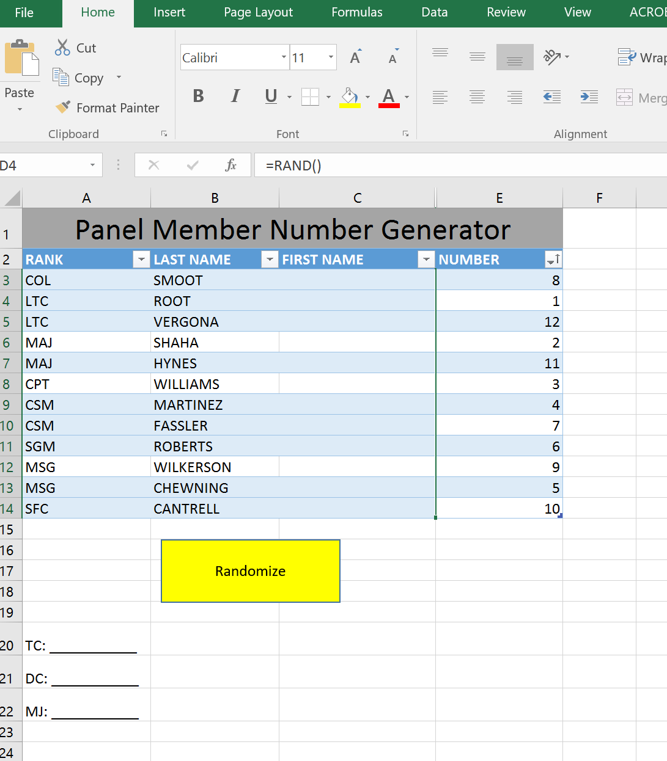
IMPANELING MEMBERS ISSUE RANDOM NUMBERS

Slide 35
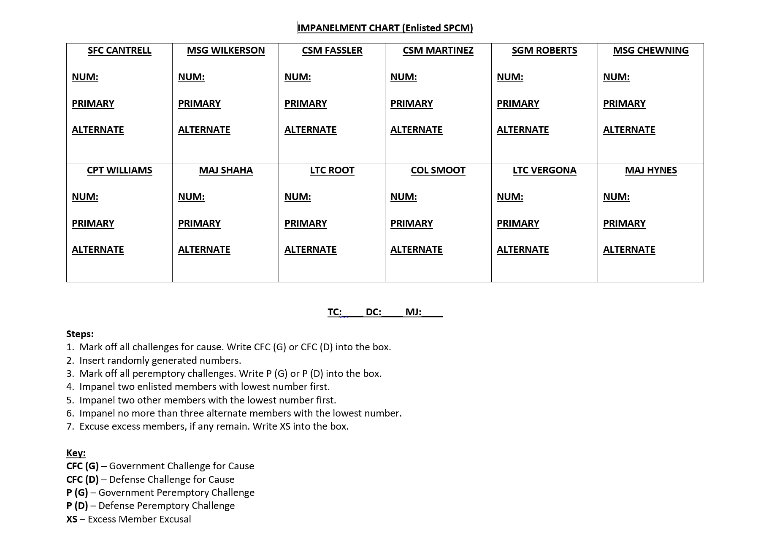
IMPANELING MEMBERS ISSUE RANDOM NUMBERS
Notes:
(i) authorized to impanel a specified number of alternate members; or (ii) authorized to impanel alternate members only if, after the exercise of all challenges, excess members remain. [shall not exceed three alternate members]

Slide 36
IMPANELMENT DEMONSTRATION

Slide 37
MAJ
MAJ
MAJ
CPT
CPT
CPT
CPT
1LT
6
2
1
7
4
5
3
8
* Challenges for cause
* MJ gives each member a random number
* Peremptory challenge
* MJ impanels members by lowest random number to meet the required forum
* After MJ impanels required forum, the MJ will then assign alternates by lowest random number
* MJ dismisses the excess member
What if the convening order says the Military Judge shall impanel 1 alternate member?
What if the convening order says the Military Judge shall impanel alternate members if such members are available after identification of the primary members?

Slide 38
MAJ
MAJ
MAJ
CPT
CPT
MSG
SFC
SSG
SSG
SGT
6
2
1
7
4
9
3
8
5
10
* Challenges for cause
* MJ gives each member a random number
* Peremptory challenge
* MJ impanels enlisted members by lowest random number first, then other members
* After MJ impanels required forum, the MJ will then assign alternates by lowest random number
* MJ dismisses the excess member
What if the convening order says the Military Judge shall impanel 2 alternate members?
What if the convening order says the Military Judge shall impanel alternate members if such members are available after identification of the primary members?
Notes:
What if the convening order says the Military Judge shall impanel 2 alternate members?
What if the convening order says the Military Judge shall impanel alternate members if such members are available after identification of the primary members?

Slide 39
JEOPARDY WHAT IS NEW?
Article 44(c)(1) and (2), UCMJ
A court-martial with a military judge alone is a trial in the sense of this section (article) if, without fault of the accused—
(A) after introduction of evidence; and
(B) before announcement of findings…
A court-martial with a military judge and members is a trial in the sense of this section (article) if, without fault of the accused—
(A) after the members, having taken an oath as members under section 842 of this title (article 42) and after completion of challenges under section 841 of this title (article 41), are impaneled; and
(B) before announcement of findings…
WHY?
To align the military system with federal civilian standards
Notes:
In federal court jeopardy attaches when jury members take their second oath as members. To align with this practice, Article 44 attaches jeopardy when members are impaneled, closely resembling federal practice.

Slide 40
CHECK ON LEARNING
True or false: When the accused elects an enlisted panel, the military judge will always impanel enlisted members first.
True, the military judge will impanel enlisted members with the lowest random number to meet the forum requirements
True or false: The impaneled alternate member with the highest random number will replace an excused primary member.
False, The alternate member with the lowest random number will replace the excused member

Slide 41
SUMMARY
Selection Criteria and Panel Selection
Alternate Members
Process of impaneling members
Jeopardy and when it attaches
Questions

